Slide 1
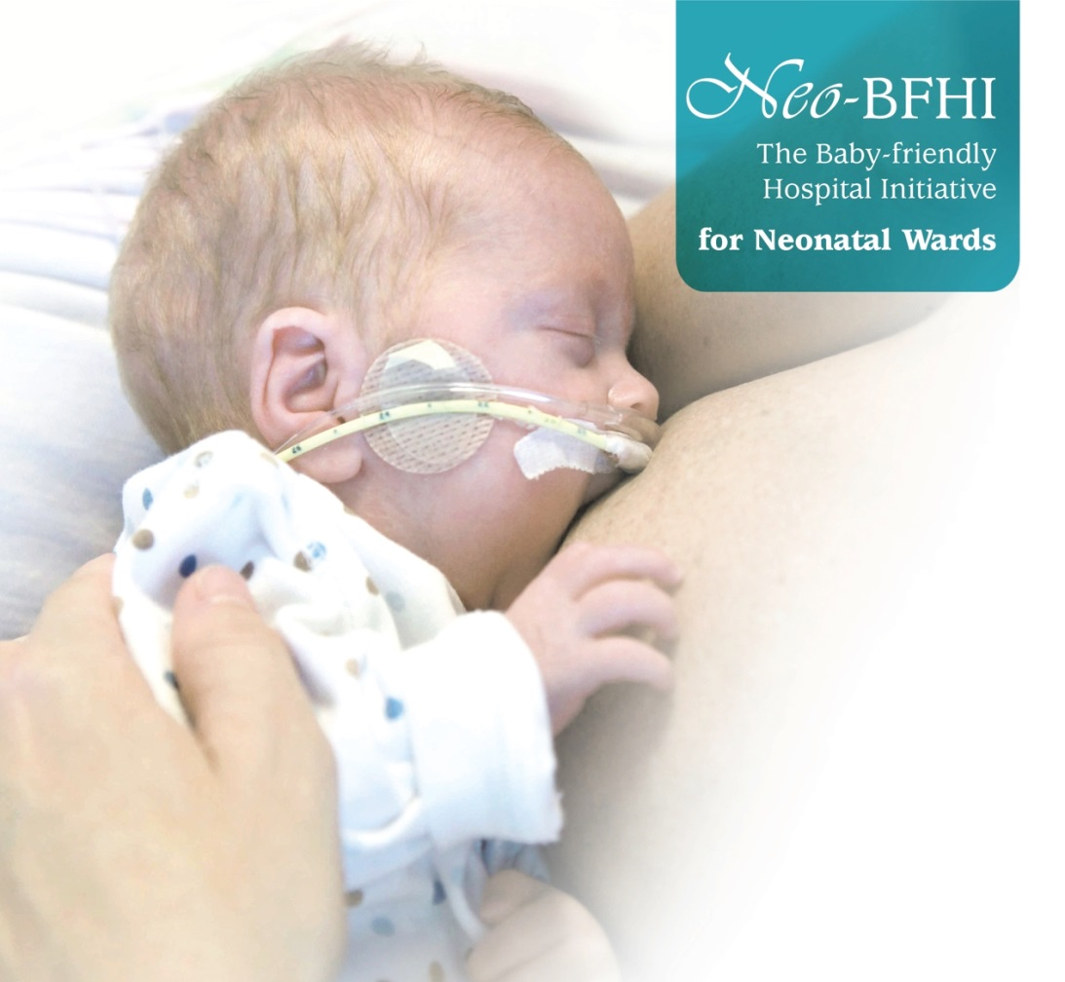



Compliance with the Baby-friendly Hospital Initiative for Neonatal Wards (Neo-BFHI).
A cross-sectional study in 36 countries.
Ragnhild Maastrup, PhD, RN, IBCLC (Denmark)
Laura N. Haiek, MSc, MD (Canada)
And the Neo-BFHI Study Group

Slide 2
Disclosure statement
The authors have no relationships to disclose relevant to this topic.

Slide 3
Background
Historically neonatal wards present barriers to breastfeeding
The Neo-BFHI Guiding Principles and Steps were published in 2012-13 and the standards and recommendations in 2015.
Breastfeeding related policies and practices in neonatal wards are not well documented internationally, only Denmark and Spain have national surveys (Maastrup 2012, Alonso-Diaz 2016).

Slide 4
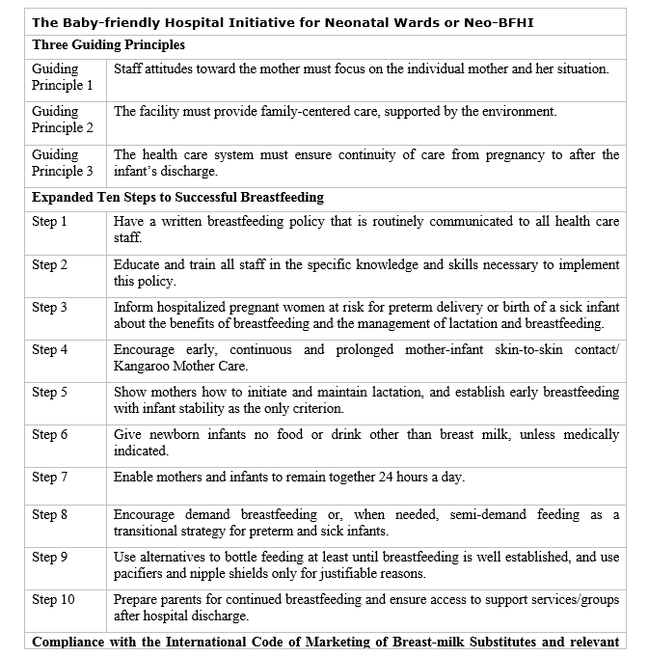

Slide 5
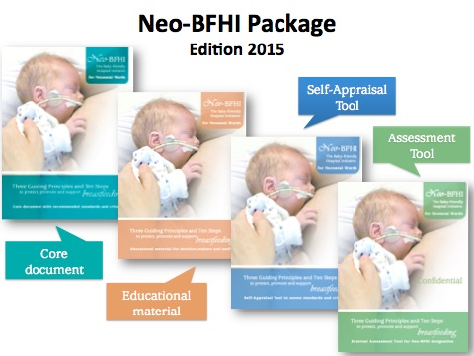
http://www.ilca.org/main/learning/resources/neo-bfhi
Notes:
A confidential assessment tool, which was pilot testet twice in a total of 18 countries.

Slide 6
Aim
To measure compliance with the Neo-BFHI’s expanded Ten steps to Successful Breastfeeding, The Code, and three Guiding Principles in neonatal wards globally.

Slide 7
Methods
Principal investigators: Ragnhild Maastrup, Denmark and Laura Haiek, Quebec, Canada.
Country survey leaders in each country enrolling wards and ensuring data collection.
Survey using a Self-Assessment questionnaire, based on the Neo-BFHI Self-Appraisal Tool.
15 different languages, most online.
Pilot-tested in Quebec, Denmark, UK and France.

Slide 8
Methods
Data collected February – December 2017
All levels of neonatal wards were eligible to participate
Sent to head nurse or medical director of neonatal wards

Slide 9
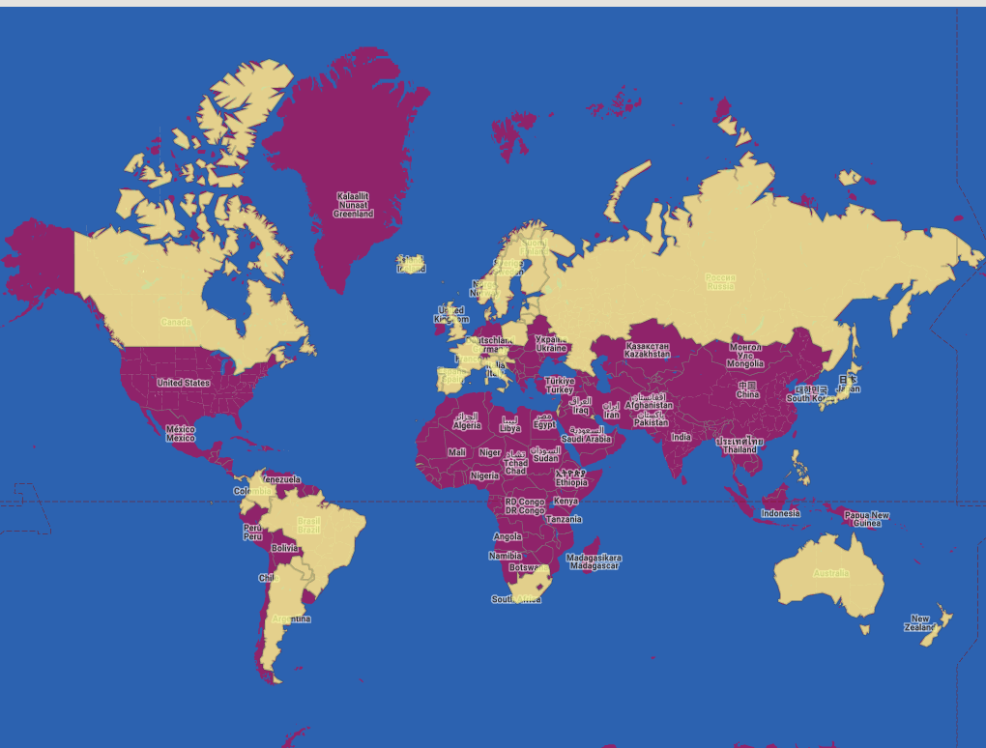
20
1
5
2
6
2
917 neonatal wards (64% level 3)
36 low, middle, and high-income countries from all continents participated (yellow)

Slide 10
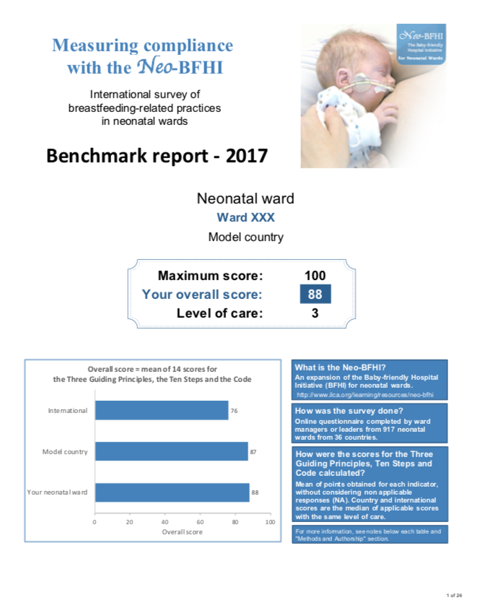
Analysis
Partial and Overall Compliance scores:
Based on 63 indicators for the GPs, Steps and Code
Mean scores for each ward presented in a benchmark report
Country (regional) and International scores presented as median scores

Slide 11
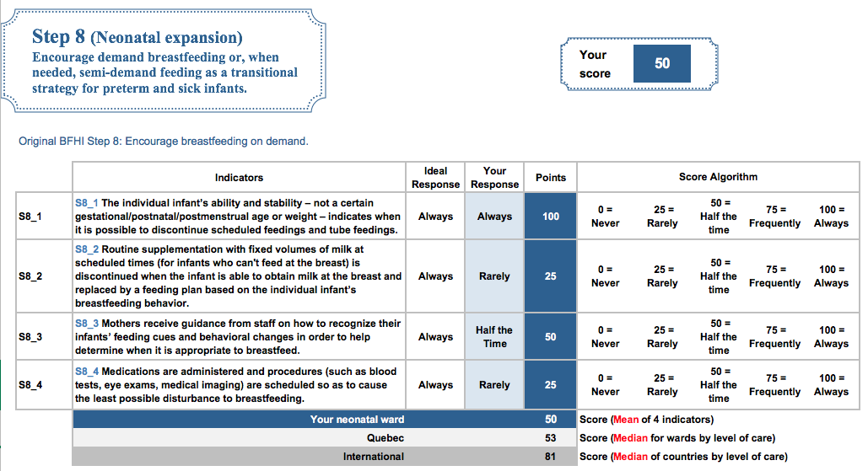
Calculation of scores for each GP, Step and the Code for an individual NICU
Range 0 - 100

Slide 12
Results
917 neonatal wards (64% level 3)
International median score 77 (Country range 52 - 91)
Highest scores
  Guiding Principle 1 (respect for mothers) 100
  Step 5 (breastfeeding initiation and support) 88
  Step 6 (human milk use) 88
Lowest scores
  Step 3 (antenatal information) 63
  Step 7 (rooming-in) 67

Slide 13
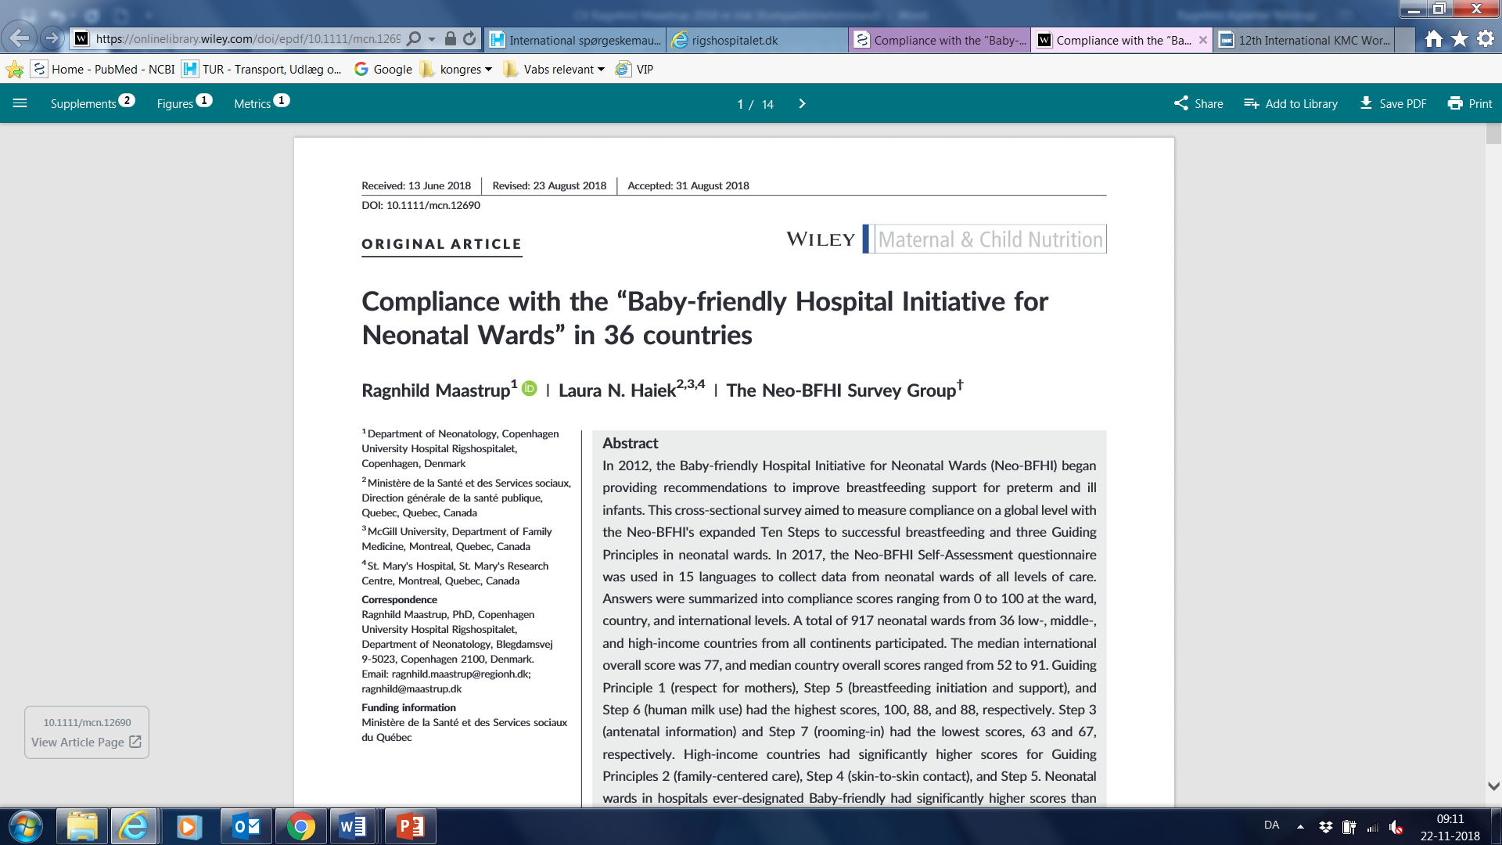
Results
Figure from article

Slide 14
Figure from article

Slide 15
BFHI/non-BFHI
Neonatal wards situated in a hospital ever-designated Baby-friendly had significantly higher Ward Overall scores [mean 83.2 (95% CI 82.0 – 84.3)] than wards in non-BFHI hospitals [mean 72.3 (95% CI 71.1 – 73.4)] (p<0.0001).
This was also true for all Partial scores.

Slide 16
Income and Partial scores
High-income countries had significantly higher scores for
  Guiding principle 2 (family-centered care) [median 83 (95% CI 79.1–87.7) versus 71 (95% CI 63.8 – 78.3), p=0.0023]
  Step 4 (skin-to-skin contact) [median 79 (95% CI 74.0 – 83.8) versus 63 (95% CI 48.3 – 77.7), p=0.0091]
  Step 5 (breastfeeding initiation) [median 87 (95% CI 84.5 - 89.7) versus 81 (95% CI 75.0 - 87.3),
  p= 0.0316].

Slide 17
Conclusion
Country scores higher than 50 for all 36 participating countries demonstrate that neonatal wards around the world are working to support breastfeeding.
The study indicates international readiness to expand Baby-friendly standards to neonatal settings. Hospital and governments should increase their efforts to promote, protect and support breastfeeding in preterm and ill infants.
Neonatal wards may differ considerably in Neo-BFHI compliance, both within and across countries.
Further research should include parents’ perspective, ensure participation of more low-income countries, and explore the effect of implementing the Neo-BFHI on breastfeeding outcomes.

Slide 18
Thank you for your attention
Published September 10, 2018
Contact information:
Laura N. Haiek
Laura.haiek@msss.gouv.qc.ca
Ragnhild Maastrup
ragnhild.maastrup@regionh.dk

