Slide 1
14-Mar-2022
Mechanical ventilation and late brain injury in the SafeBoosC-III trial.
Draft protocol for an ancillary study.

Slide 2
Power calculation
1600 infants
1250 survivors
950 mech vent 300 not mech vent
IVH 17%
Cerebellar H 4%
cPVL 5%
PHVD 12%
Atrophy 5%
250? late brain injury 1000? not late brain injury
https://www.openepi.com/Menu/OE_Menu.htm

Slide 3
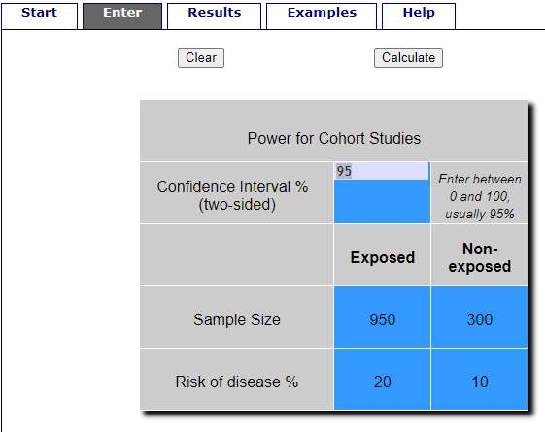
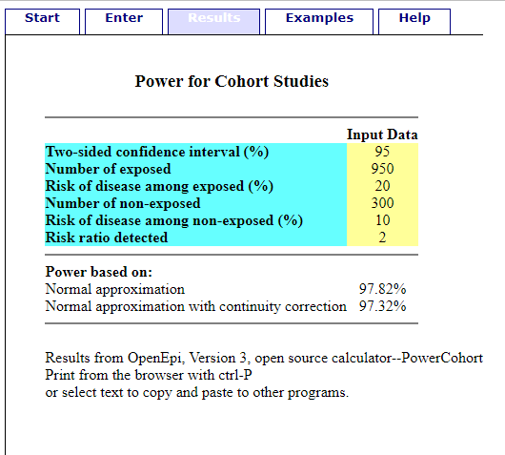

Slide 4
If there is an association
– why?
Causation!
http://dagitty.net/mJ_N76S

Slide 5
